Slide 1

Heterojunctions: An Introduction
A heterojunction is a junction formed between two semiconductor materials with different band gaps. Unlike homojunctions, which use the same material, heterojunctions offer unique properties that are essential in optical and electronic devices. Common materials include Silicon (Si) and Gallium Arsenide (GaAs), which have different band gaps causing discontinuities at their interface.
This difference leads to band offsets in conduction and valence bands, significantly impacting devices like LEDs, solar cells, and transistors.

Slide 2
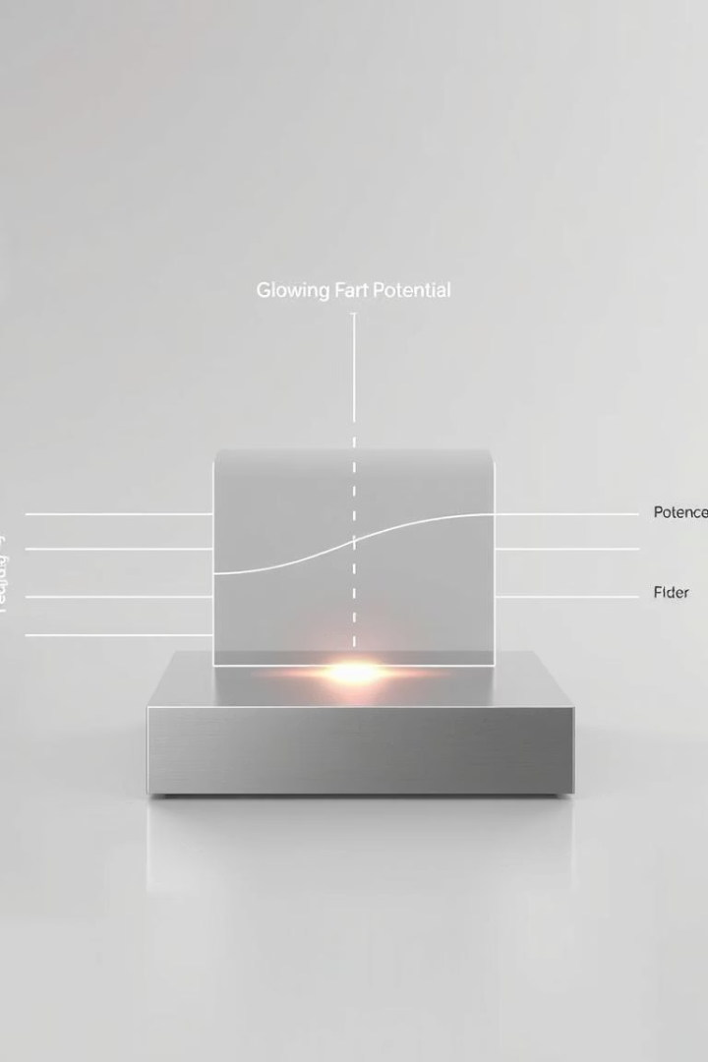
Built-in Potential in Heterojunctions
Origin of Built-in Potential
Mathematical Expression
Built-in potential (Vbi) arises from differences in carrier concentrations—donor (ND) and acceptor (NA)—between the two materials.
Vbi = (kT/q) ln((NA ND)/ni2), where k is Boltzmann constant, T temperature, q elementary charge, and ni intrinsic carrier concentration.
Significance
This potential governs carrier transport and depletion regions, influencing device behavior.

Slide 3
Energy Band Diagram of a Heterojunction
Conduction Band Offset (ΔEc)
Valence Band Offset (ΔEv)
Difference in conduction band energies between two materials, calculated as ΔEc = χ2 − χ1, where χ is electron affinity.
Difference in valence band energies, given by ΔEv = ΔEg − ΔEc, where ΔEg is the band gap difference.

Slide 4

Carrier Concentrations in Heterojunctions
Electron Concentration (n)
For n-type material, n = (ni2)/NA, where NA is acceptor concentration.
Hole Concentration (p)
For p-type material, p = (ni2)/ND, where ND is donor concentration.

Slide 5

Band Gap and Its Role
Definition
Impact on Electrons
The band gap (Eg) is the energy difference between the valence and conduction bands.
Larger band gaps require more energy for electrons to jump from valence to conduction band.
Heterojunction Advantage
By combining materials with different band gaps, heterojunctions enable tuning of device performance.

Slide 6




Applications of Heterojunctions
High-Efficiency Solar Cells
LEDs and Laser Diodes
Transistors
Integral to high-performance transistors, especially for high-frequency applications.
Heterojunctions allow efficient energy conversion by combining different semiconductors.
Used to enhance light emission efficiency in optoelectronic devices.

Slide 7
Design Considerations for Heterojunctions
Band Offsets Control
Carrier Concentration Management
Precise control of conduction and valence band offsets is critical for optimizing carrier transport.
Adjusting donor and acceptor concentrations affects built-in potential and device efficiency.

Slide 8

Conclusion: Importance of Heterojunctions
Unique Properties
Heterojunctions create band offsets and control carrier concentrations, enabling advanced device functions.
Device Optimization
Understanding heterojunction physics is key to designing efficient optoelectronic and microelectronic devices.
Future Impact
Continued innovation in heterojunction technology drives improvements in LEDs, solar cells, and transistors.

